Slide 1
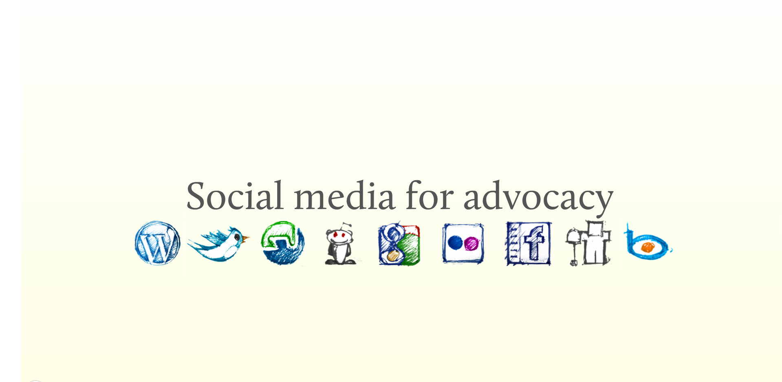
Why Care About Social Media?

Slide 2
What Are Your Goals?
Raise Awareness About An Issue?
Convince Others To Join Your Cause?
Encourage Someone To act?
Contact legislative members?

Slide 4
The Social Circle
Listen
Strategize
Impact
Share
Influence

Slide 5
Listen
to the people you are trying to reach.

Slide 6
Who do they talk to?
How do they talk to each other?
When do they talk to each other?
Where do they talk to each other?

Slide 7
Strategize
Everyone needs a plan.

Slide 8
Think about what catches your attention online
Cool, funny, bold or creative content
Someone talking about you
Someone talking about your friends

Slide 9
Implement
& Impact
Create messages that are creative, engaging,
informational and valuable to your audience

Slide 10
Share
Share your own content as well as that of others
Sharing is everything in social media
K.I.S.S – Keep It Simple Silly. Make your content
easy to share
Notes:
Reach out to other people, build online coalitions, their audience will become your audience. Word of mouth is the most powerful tool.

Slide 11
Influence
&
Access
Social media gives you the
ability to connect with
those you never had access to
It’s free, that means
unlimited access
Influence these
connections effectively

Slide 12
Responsibility & Consistency
You are responsible for your
organization’s brand
Be consistent in your
messaging and image

Slide 13
Twitter Tips
@ - Post a tweet directly to your legislative member
When mentioning someone, always use their twitter handle
# Hashtags are used across
multiple social media platforms to organize
the conversation around a keyword
When used properly, these tags allow users to
find and follow updates around a topic or an event
#caregiving
RT Retweet relevant information from others. This will make them notice you
Share
Twilert
140 – With only these characters to work with,
you have to shorten everything
Use bitly.com to shorten links
Google Alerts
Notes:
Type in keywords.

Slide 14
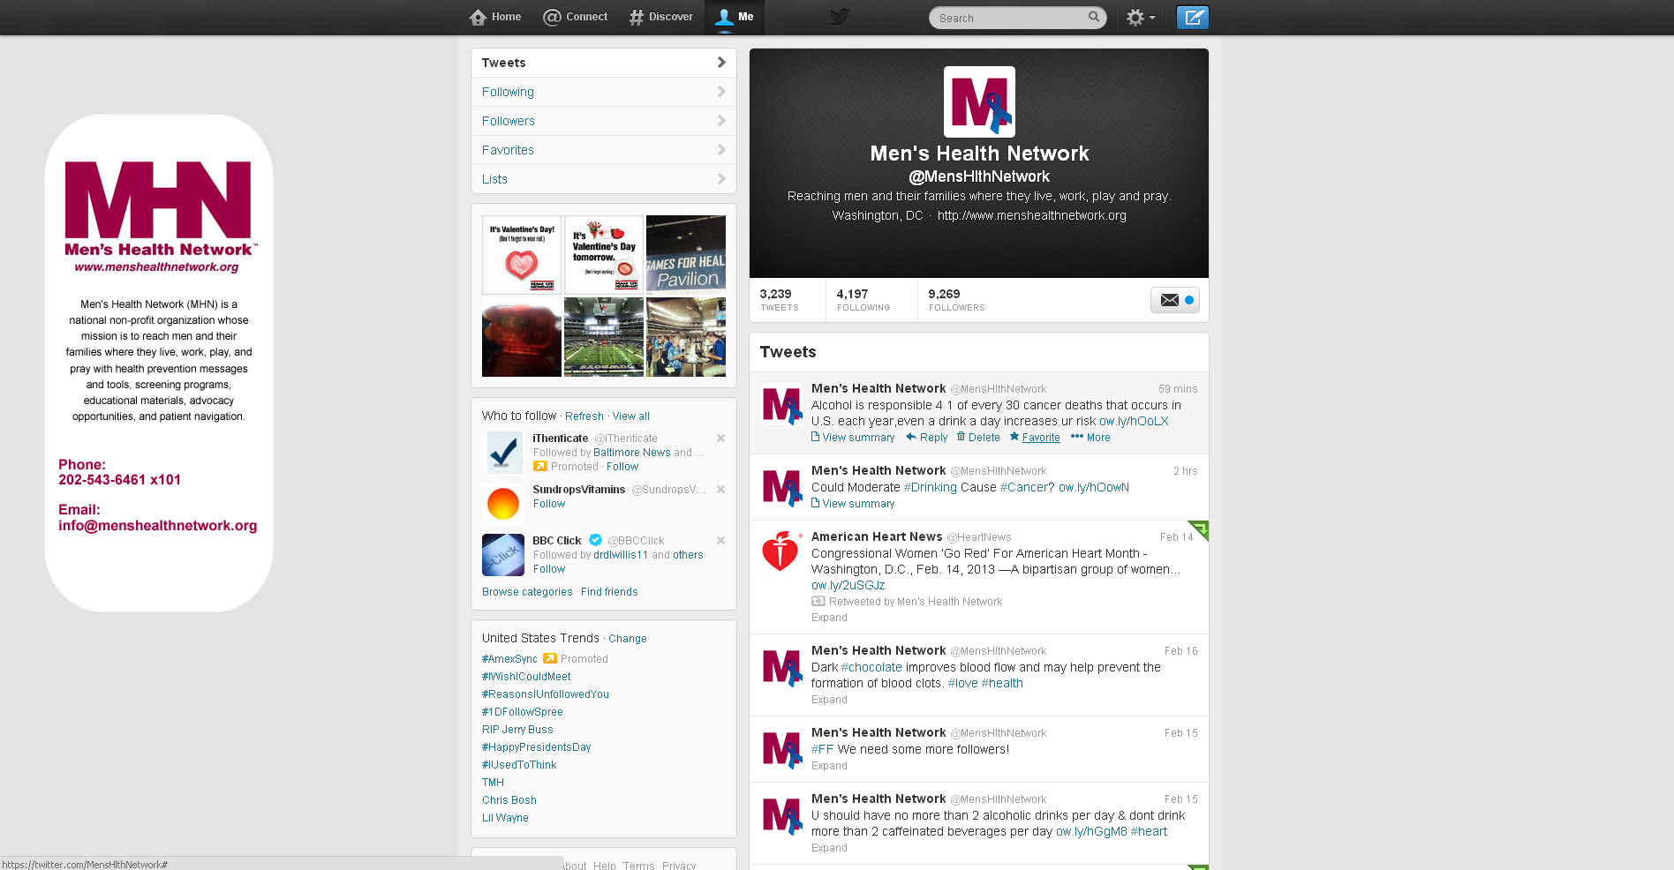

Slide 15
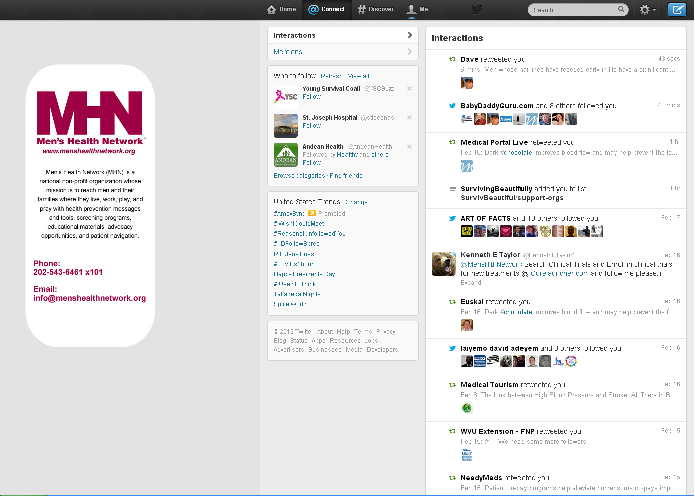

Slide 16
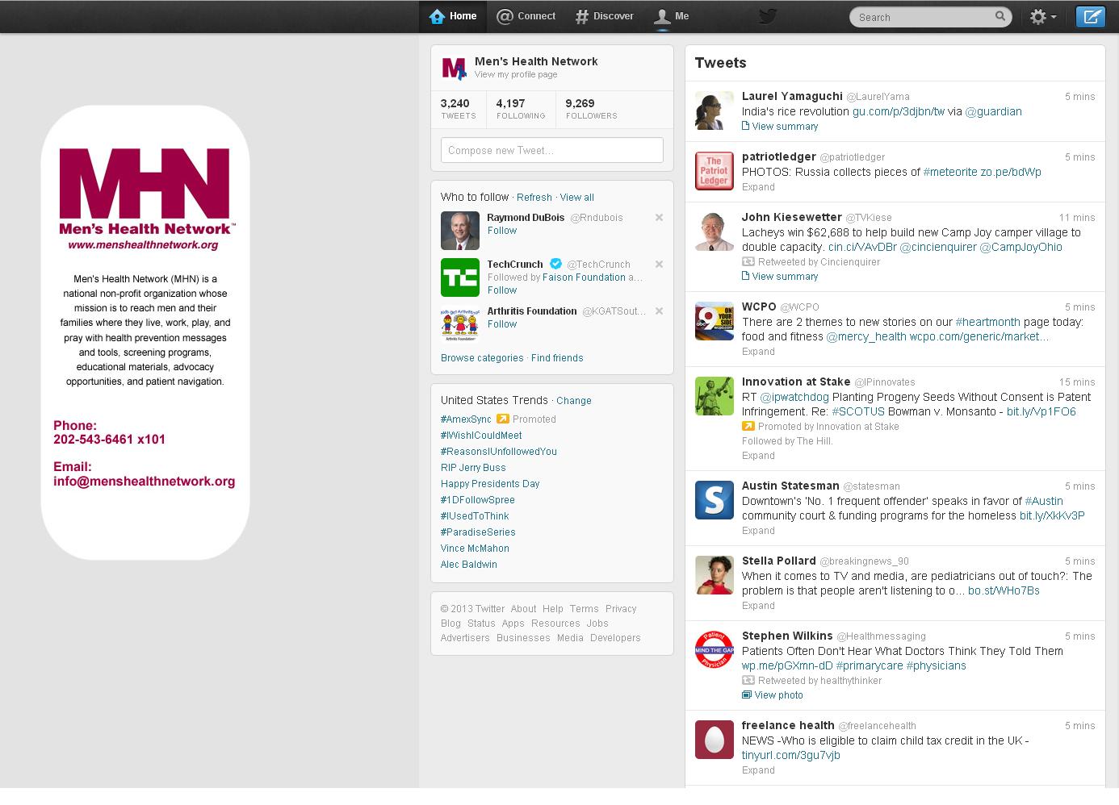

Slide 17
Handles & Hashtags
@SenatorHarkin – Sen. Tom Harkin
@SenAlexander – Sen. Lamar Alexander
@SenSanders – Sen. Bernie Sanders
@SenBillNelson – Sen. Bill Nelson
@RepFredUpton – Rep. Fred Upton
#caregiving
# *insert disease*
Notes:
Senators involved in Older Americans Act.

Slide 18
Operation Twitter
Let’s Play Tag
Hash It Out
#caregiving
Show Me What You Tweet
Notes:
Decide a person to tag who is relevant to caregiving. Use #caregiving

Slide 19
Caring For Facebook
Like – Like pages and that will bring you more ‘Likes’
Pictures - Nothing works like good visuals on Facebook
Legislative Members: Post directly on
their walls to get noticed
Schedule – Try not to post more than 1-2 times a day You don’t want to spam your fans
Events – Post your events on Facebook and invite your friends to create a buzz
Notes:
Facebook is like your living room. Ask stien to pull up men’s health network FB page.

Slide 20
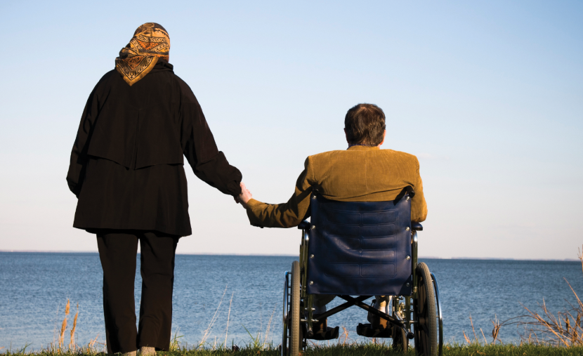
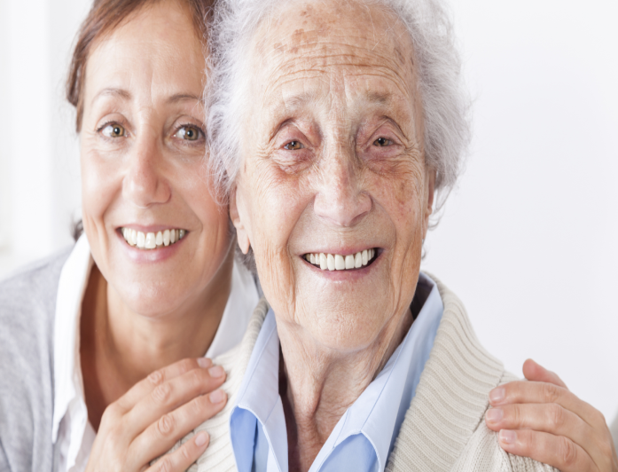
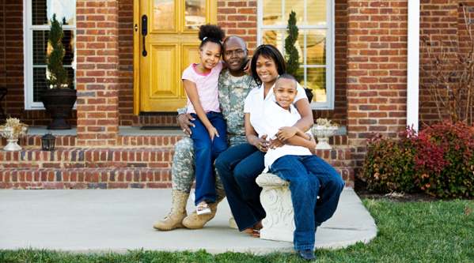
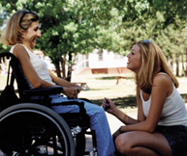

Slide 21
Operation Facebook
Craft a message
Use a photo
Be visual
Be effective
Don’t go word crazy
Notes:
Ask stien to get a photo. Ppl have a short attention span. Won’t read much.

Slide 22
Other Social Media Platforms
Youtube
LinkedIn
Instagram
Pinterest
Flickr
Hootsuite

Slide 23
Contact Me
Kimaya Dixit
Men’s Health Network
communications@menshealthnetwork.org
202.543.6461 x 101
www.menshealthnetwork.org
Twitter - @menshlthnetwork
Facebook – www.facebook.com/MensHealthNetwork

