Slide 1
Advocating for Caregiving From the Roots Up
John Schall
Chief Executive Officer
Caregiver Action Network
March 13, 2013
JSchall@CaregiverAction.org

Slide 2
Who We Are
CAN’s Mission…
…is to promote resourcefulness and respect for the more than 65 million family caregivers across the country.

Slide 3
What We Do
CAN Connects Caregivers with
Valuable Resources
Advice from Caregiver Voices
Peer Support
Caregiving Information
Advocacy for Caregivers

Slide 4
CAN’s Goals
Create Resourceful Caregivers
Serve an increasing number of family caregivers with practical help, support and information.
Reduce Caregiver Stress
Improve the quality of life for family caregivers by reducing their day-to-day stress and financial distress.
Create Respect for Family Caregivers
Advance the case for family caregiver recognition and support.
Create Capable Caregivers
Build family caregiver confidence and capability through the dissemination of educational programs that demonstrate a positive impact on the lives of family caregivers.

Slide 5
CAN’s New Interactive Website
Organized by Four Profiles:
I just realized I’m a family caregiver now.
I have been a family caregiver for years.
I live far away and I’m on the caregiving team.
I have a job and I’m the caregiver for my loved one.

Slide 6
Let’s Take a Look at the States
Which states do well?
AARP’s “State Scorecard on Long-Term Services and Supports for Older Adults, People with Physical Disabilities, and Family Caregivers”
Any discernible trends?
What to watch for?

Slide 7
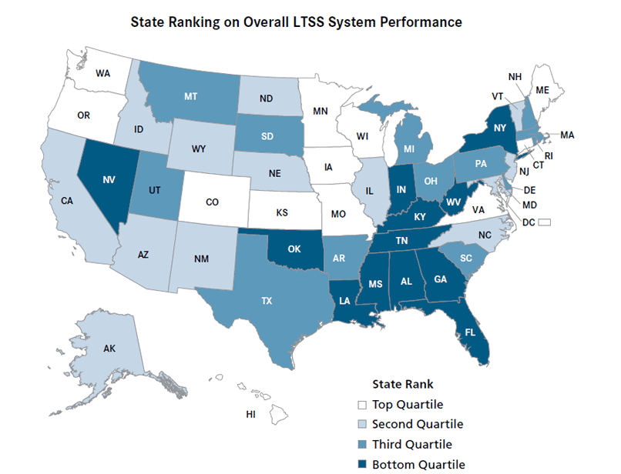

Slide 8
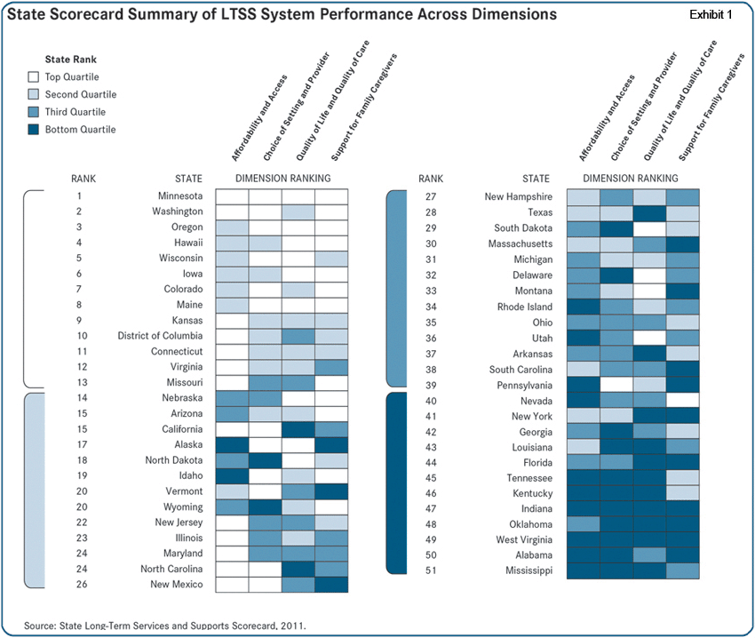
Source: AARP State Long-Term Services and Supports Scorecard, 2011

Slide 9
Examples of Current State Efforts
Rhode Island: caregiver assessment
Vermont: Support and Services at Home model programs
New Jersey: tax credits
Source: Family Caregiver Alliance Policy Digest Feb. 19, 2013

Slide 10
State Trends
In the last few years
Now
Family and medical leave
Tax incentives
Respite care
Medicaid benefits
Tax incentives
Medicaid benefits
Care coordination
529 Programs
Respite care

Slide 11
State Trends Summary
A lot gets introduced, not a lot gets passed
Not much of a pattern across states
New: Family caregiver discrimination laws in 63 localities in 22 states
Watch for: possible new 529 programs (akin to college savings programs)

Slide 12
Advocacy Tips
It’s about relationships, not just contacts
Use personal stories
Hit them several times during the year
Use National Family Caregivers Month
State and local proclamations
Use the State Scorecard – whether good or bad

Slide 13
Access to Grass Roots
CAN’s Story Project database searchable by state, disease condition, relationship, etc.
Alzheimer’s videos
USA Today caregiving section this Friday
National TV Public Service Announcement
CAN’s Online Forum

Slide 14
How to Connect with CAN
www.CaregiverAction.org
www.facebook.com/CaregiverActionNetwork
@CaregiverAction

