Slide 1

Technologies to Strengthen and Support the Caregiver Network
Majd Alwan, Ph.D., SVP Technology, LeadingAge, CAST Executive Director
6th Annual National Conference for Caregiving Coalitions
July 10, 2012

Slide 2

What is CAST?
Providers of
Aging Services
Tech Industry
Partners
University
Researchers
CAST
Associations
The Center for Aging Services Technologies is a national coalition of more than 400 organizations working together to improve the aging experience through technology
Notes:
Large multi-national companies like Intel, Philips, GE, as well as smaller start-up companies including the Intel-GE Joint Venture Care Innovations LLC.
Part of the LeadingAge, the Center for Aging Services Technologies (CAST) is a national coalition comprised of more than 400 organizations working together to improve the aging experience through technology.
It has an advisory body called the “CAST Commission” comprised of sponsoring organizations.

Slide 3
CAST Focus Areas
  Pilots: Identifying needs and accelerating applied research
  Policy: Identifying barriers and advocating to remove them (Federal and State)
  Standards: Promoting development and adoption of interoperability standards
  Education: Disseminating information and resources.
Notes:
CAST can be thought of as a “facilitator” and an “advocacy” organization
Our 4 focus areas are:
Pilots:
-We encourage providers to start using technology by piloting with specific goals and consumers
-We are also promoting larger “living laboratory” pilot projects with solid research methods to support the case for the value and cost/benefit to help move policy change

Slide 4
Vision: “Shift Left” through Technology
HOME CARE
100%
Healthy,
Independent Living
Community
Clinic
Chronic
Disease Management
Doctor’s
Office
RESIDENTIAL CARE
QUALITY
of LIFE
Assisted Living
ACUTE CARE
Specialty
Clinic
Skilled
Nursing Facility
Community
Hospital
ICU
0%
$1
$10
$100
$1,000
$10,000
COST of CARE/DAY
Notes:
Average age and frailty of those who end up in a Nursing Home or Assisted Living is on the increase.
Majority of providers are exploring ways to improve efficiencies in campus settings and leverage their staff to deliver home and community-based services into the community. “Assisted Living At Home” is one of those models, where technology can be used to deliver services on an as needed basis as opposed to a schedule.

Slide 5
CAST Vision Video
Portrayed technologies for:
Safety
Monitoring wellness
mHealth for Chronic Disease Management for Caregivers
Social connectedness
Interoperable health records that allow health information exchange.
http://www.leadingage.org/Imagine-the-Future-of-Aging.aspx
Notes:
In 2005, we produced a video entitled “Imagine the Future of Aging” for the White House Conference on Aging. The video portrayed several technologies. Examples include:
A System with sensors in the home that monitors activities and alerts a caregiver if there is something unusual or in case of an emergency
A stove that shuts off automatically if forgotten unattended
A medication adherence device that organizes, reminds, dispenses and monitors medications
Devices that allow seniors and caregivers to take vital signs, self-manage chronic conditions and alert a clinician when the readings are abnormal to intervene early. It portrayed the caregiver using mHealth to manage her diabetes.
Cognitively stimulating games with embedded cognitive assessment
2 way video conferencing and on-line communities for seniors, and
An electronic health record that allows multiple care providers to update and share information, to improve care coordination particularly around transitions.
These technologies are a reality today, and we’ve come a long way from the “I’ve Fallen and Can’t Get Up” personal emergency response systems (PERS). I provided a link to the video in your hand-outs.

Slide 6
Imagine with me…
Notes:
Play Video from DVD

Slide 7
Technologies Available Today
Notes:
Play Video from DVD (7 minutes)

Slide 8

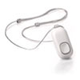
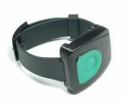
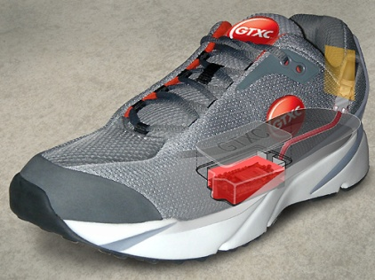
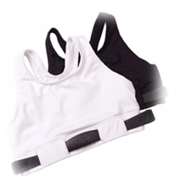
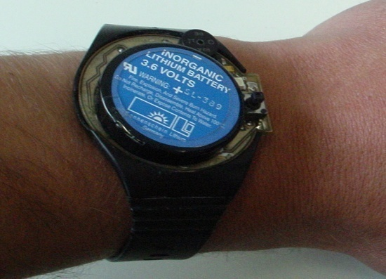
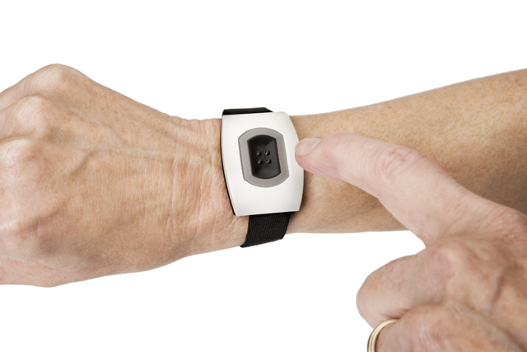
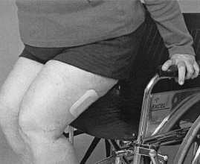
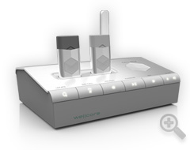
Safety Technologies
Wearable devices: (PERS, automatic fall detectors, fall prevention patches, tracking)
Notes:
Advantages sense of security, peace of mind. Have the potential to prolong independence.
Disadvantages: require user’s compliance in wearing the device. 76% of falls in the community
The ones that require user activation may not be activated due to being incapacitated, confused, or unwilling to disturb anyone! Which defeats the purpose.
Automatic fall detectors do not require user activation, but are susceptible to missing an event (false negative) or being triggering (false positive)
Some integrate tilt sensor and most integrate a push button
Fall prevention patches is dependent on many factors including staffing levels, signal flow and process flow.
8

Slide 9
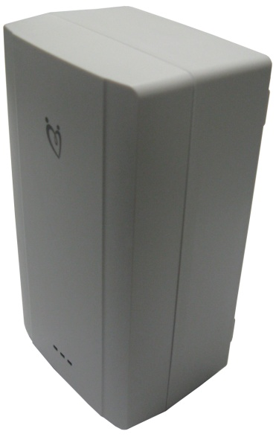

Safety Technologies
Environment/Passive (motion-based sensor monitoring systems, embedded fall-detection systems, stove use detectors, temperature/smoke monitors, safe lighting technologies)
Notes:
These systems do not require the activation/ intentional interaction from the user
Motion-based systems detect lack of motion, and hence possible/probable falls
Subject to false positive/ negative detection and require a “higher level of intelligence”. Better context awareness/ context understanding is needed.
While false positives are annoying, the cost of false negatives is much higher!
2 edged sword! Need to be integrated with comprehensive assessment, including medications and home review, and prevention program (exercise).
We should consider what people want vs. what people need (which is what researchers tend to focus on).

Slide 10
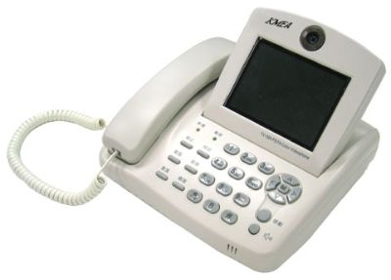
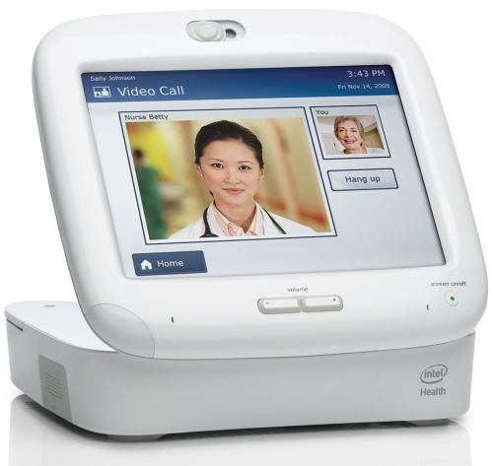
Telehealth
Telemedicine/ Tele-health (biometrics: pulse, BP, glucose, temperature, weight; daily wellness check; 2- way video health consultations care coordination; medication compliance)
mHealth is the new wave of telehealth using mobile devices
Notes:
Talk about the evidence and the review of telehealth in hypertension.

Slide 11
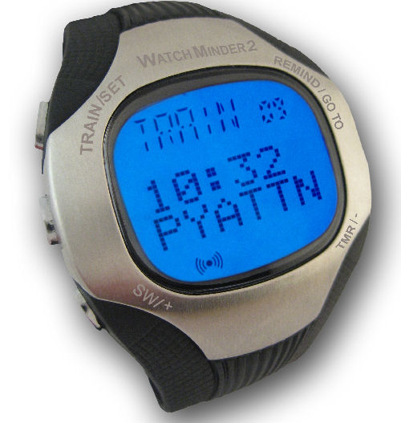
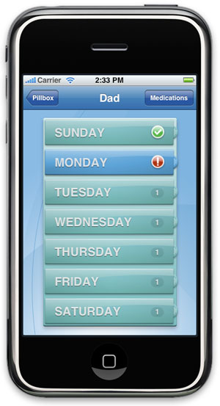
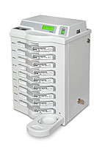
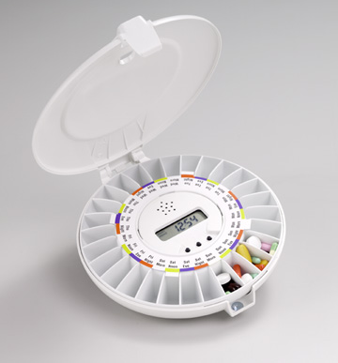
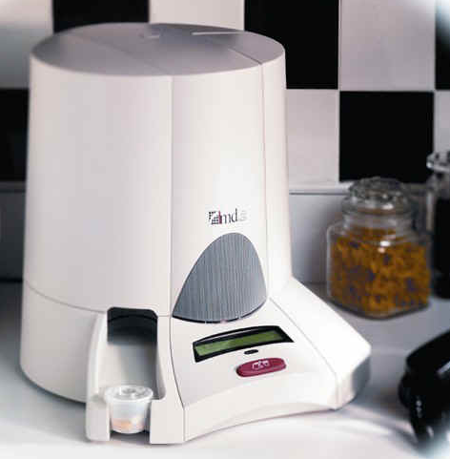
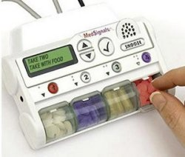
Medication Adherence
Medication Reminder systems
  Portable (wrist watch, pager), cell phones with pill reminders, dispensers (mostly unmonitored)
  Monitored dispensers
Notes:
Medication reminders systems/ organizers/ dispensers. Organizers have compartments for medications. Dispensers only allows access to medications at the preprogrammed times.
Most requires the caregiver, in some cases a professional caregivers, to load the medications and program the device.
Most of the portable dispensers ones are unmonitored. Most non-portable dispensers are monitored i.e. they can connect over phone line or the Internet and upload whether medications have been taken when dispensed or not, time they were taken etc.

Slide 12
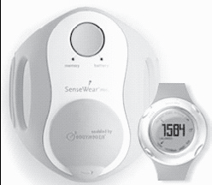

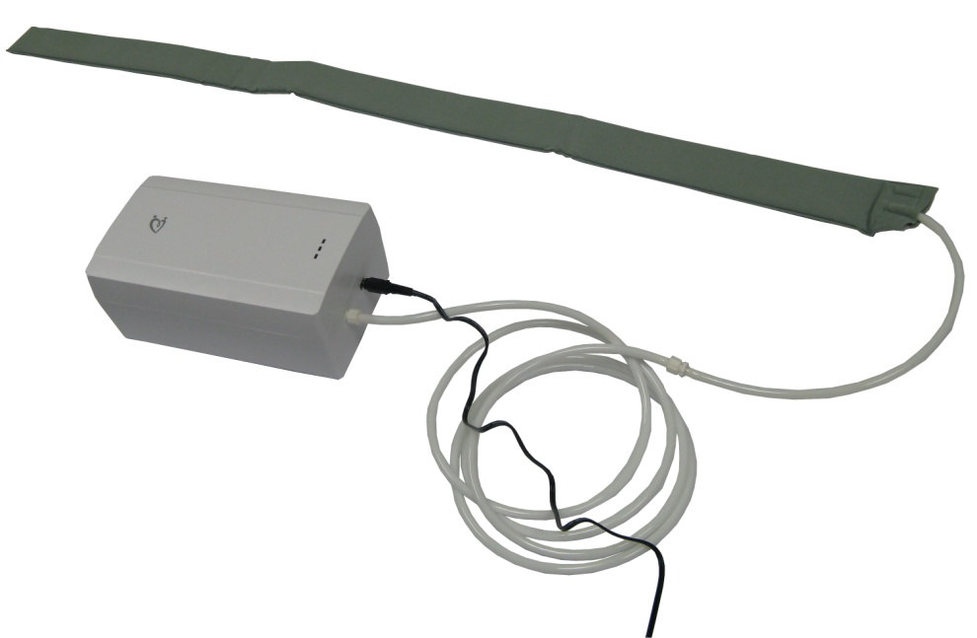
Physical Health/Wellbeing
Wearable devices (activity monitors, cardiac monitor, ambulatory blood pressure monitors)
Environment/Passive (motion sensors based activity monitors, sleep/bed sensors)
Notes:
VOA Pilot results
More engagement in managing health and improved health, reduced care cost
Currently used in chronic diseases like hypertension, CHF and COPD.
Require the compliance.
University of Virginia developed a bed monitor capable of detecting pulse, breathing rate, and sleep quality (apnea, cardiac irregularities etc.), and force and vibration sensors embedded in the walker frame or on the floor to assess walking characteristics.

Slide 13
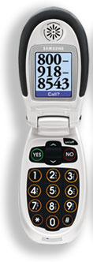
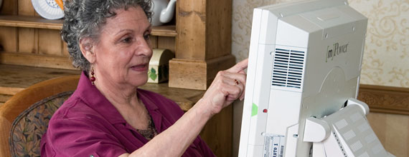

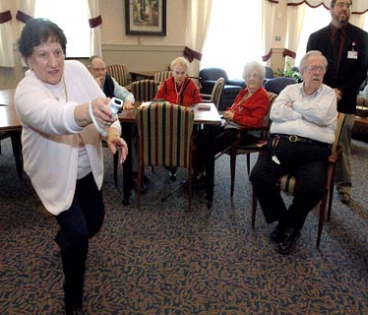
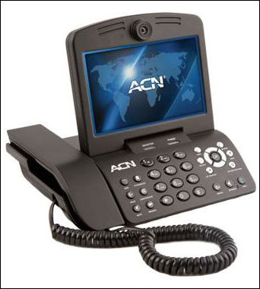
Social Connectedness
Phones (amplified phones, easy to use cell phones)
Two-way video conferencing phone
Entertainment/ Theraputainment (Cognitive and/or Physical exercise)
Notes:
Social connectedness has significant impacts on the mental as well as physical wellbeing.
Dakim, PositScience etc.
It’s Never 2 Late, Nintendo Wii
Engaging, stimulating, provide mental and in some cases physical exercise, and it is fun.
They have a great potential to change the group dynamics when used in congregate living settings, and a potential to bring different generations together.
Anyone using some of these technologies and would like to share with the group.

Slide 14
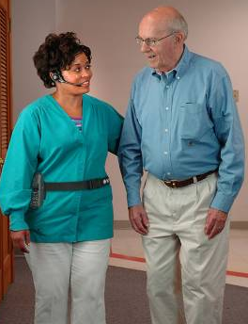
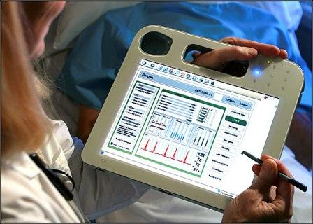
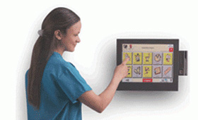
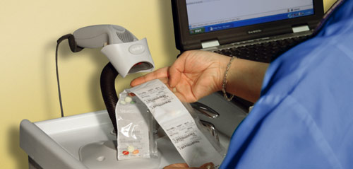
EHRs & PoC Technologies
Interoperable EHR and Point of Care systems: Electronic clinical charting; CPOE; e-Prescribing; Lab interfaces; e-MAR systems; Documentation systems; Shared care planning systems; Bedside medication dispensing; Wound care applications.
Notes:
The information systems that allow the integration of data from multiple sources and turning the data into knowledge that can help care providers make timely decisions.
These are essential but not sufficient, cite the medication compliance issues.

Slide 15
Critical Gaps
Perverse Payment Systems
Lack of Awareness
Technical Uncertainty
Limited Evidence of Value
Absence of Business Models
Notes:
15
Technical
Practicability and Scalability (e.g. reliance on the compliance of the user, usability issues, privacy concerns, acceptance, and cost)
Each device/ system has its own data structure, database, application, and interface
Electronic Personal and Health Records are still not wide-spread, and existing ones are not interoperable. Payment system
Shortage of efficacy evidence. Applied outcome oriented research with such technology in eldercare is under-funded.

Slide 16
Business Model Realities
Stuck in legacy reimbursement/ payment mechanisms
Critical need for integrated socio, cultural, economic model of care; may evolve more quickly in other countries
Promising aspects of current models (VA, Kaiser, PACE, P4P, etc.), exist but hard to generalize to other systems
Medicaid related programs are evolving more quickly due to extreme pressure.
Notes:
16

Slide 17
Health Reform Accelerates Technology Adoption
Health and payment reform: Shift from Pay for Service (volume) to Pay for Performance (quality), penalties for readmissions
Medicaid cuts
Latest Medicare cuts 11% on average
Medicare and Medicaid may be subject more cuts (debt ceiling deal)
The complexity and pace of change will bring opportunities and pose significant threats across the aging services continuum.
Notes:
Perhaps now, more than ever before -- the pace and amount of change may seem to be overwhelming and suggest that organizations shouldn’t think about their future, until the changes are better known or better defined.
But given the magnitude of opportunity as well as the potential challenges, there’s no better time than the present to develop an understanding of the potential changes and to think about how we sustain our mission in such times.
As a result, LeadingAge and CAST have a responsibility to help members
How are we organizing this work?

Slide 18
A Look into The Future: Highlights of the CAST Scenario Planning

Slide 19
Care Models & Enabling Technologies
Integrated/ Coordinated Health Care Models
Interoperable EHRs and HIE
Community-Based Support Services Models
Interoperable EHRs and HIE
Real-Estate Based Models
Interoperable EHRs and HIE
Facility management.
Telehealth
Care coordination tools
Telehealth
Care coordination tools
Remote monitoring and assistive devices
Wellness & quality of life
Telehealth
Care coordination tools
Remote monitoring and assistive devices
Wellness & quality of life

Slide 20
A Look into The Future: Highlights of the CAST Scenario Planning
http://www.leadingage.org/uploadedFiles/Content/About/CAST/CAST_Scenario_Planning.pdf

Slide 21
Preparing For the Future:
Example Case Studies

Slide 22

Support And Services at Home (SASH)
A collaborative SASH pilot is now integrated into Vermont’s health reform initiative and supported with Medicare funding
Already showing a 22% reduction in falls, 19% reduction in hospital admissions with no readmissions and a 10% reduction in physically inactive residents
Vermont projects the SASH pilot to save the state $40 million in Medicare costs.
Notes:
Cathedral Square Corporation created SASH One of the most comprehensive and compelling housing with services models I’ve seen
They partnered with Vermont’s HIE to exchange assessment data between care teams electronically.

Slide 23

Life care services at home and digital technology platform allow provider to provide wellness solutions beyond bricks-and-mortar
Deliberate steps taken to ensure understanding of, and responsiveness to, consumer needs in the community
Digital platform enabled extended services from 600 residents on campus to over 2,000 through a CCRC at home model
Staff buy-in facilitated by testing new technology in the homes of employees or their relatives
Successful sales strategy was appealing to caregivers as a “solutions & service provider” instead of a technology vendor.
Notes:
Through collaboration with academia and industry

Slide 24

How telehealth is helping a provider position itself as a partner to hospitals on avoiding readmissions
Nurses made more home visits to deliver hands-on care thanks to time saved from paperwork
Telehealth data made in-person visits focused and more productive
Hospital readmission rates for patients with congestive heart failure fell from 16 to 5%
NY State Medicaid now reimburses telehealth allowing JHL to rollout the Health Buddy to 375 individuals.
Notes:
Front Porch is another provider who created a Center for Technology Innovation and Wellbeing

Slide 25

One-stop information and referral service helps a provider meet seniors and caregivers needs, and increases home and community based services
Reduced response time to hospital referral requests from 2-3 hours to 15-20 minutes
Hospital readmission for telehealth users was 2 compared to 12 for the control group
Rather than wait for guaranteed ROI, Board recognizes telehealth as an expected standard of practice.
Notes:
Front Porch is another provider who created a Center for Technology Innovation and Wellbeing

Slide 26

Remote monitoring improved quality of life, increased staff efficiencies and decreased care costs
Remote monitoring study in Assisted Living showed reductions in care costs by 75% for monitored individuals relative to controls, due to detection of arising issues like urinary tract infections early
Remote monitoring in allowed staff to make 40% fewer physician phone consultations
Slightly increased monthly rent of assisted living units by $70 a month to pass the cost of remote monitoring through
Deploying sleep monitoring in skilled nursing units, which revealed that a third of residents were unnecessarily being awakened.
Notes:
Finally, SelfHelp has been implementing different technology platforms including activity monitoring, and telehealth devices and kiosks.
They

Slide 27

Selfhelp expands home and community based services through technology
Employs social workers to demystify technology to home care clients with chronic conditions
Partnered with Microsoft to install Internet service, video camera, microphone and computer with easy-to-use touch-screen monitor in the homes homebound seniors through the Virtual Senior Center project
Working towards a membership model where Virtual Senior Center participants would pay a monthly fee for use of the connectivity tools.
Notes:
Finally, SelfHelp has been implementing different technology platforms including activity monitoring, and telehealth devices and kiosks.
They

Slide 28

Common Threads Emerging from the Case Studies

Slide 29
Business Case & ROI
Immediate ROI is not easy to calculate, indirect and often intertwined with other operations
Market differentiation and strategic partnership positioning are used as a foundation for Future Revenue
Many are willing to invest in the future and defer ROI
Quality of care, helping older adults avoid higher levels of care, and staff efficiency are important secondary ROIs.
Notes:
This is evidenced by higher adoption rates of EHRs, telehealth an point of care technologies by not-for-profit care providers because you are driven by your mission and a quest for better care and services for the populations we serve rather than bottom-line.

Slide 30
Promising Models
Partnering with Hospitals to coordinate
care
Targeting the needs of seniors and caregivers in the community through call centers, enhanced referral networks and retail outlets
CCRC at home/without walls models
Building on Medicaid Waiver programs, and health reform initiatives.
Notes:
Hospital readmission reduction initiatives is an excellent starting point and represent a wide open opportunity, because unlike ACOs, Medical Home and Bundling of Payment models, every hospital will have to avoid the penalties.

Slide 31
Preparing For the Future:
Developing Technology-Enabled
Long-Term Services and Supports for a New Population of Older Adults
http://www.leadingage.org/uploadedFiles/Content/About/CAST/Resources/Preparing_for_the_Future_Case_Studies.pdf

Slide 32
More To Come…
Just released a whitepaper on EHRs, an EHR On-line Selection Tool
Collected EHR Case Studies and getting ready to release them
Contemplating a new video aimed at LTPAC providers and their potential strategic partners
Considering practical guidance tools and implementation guides, as companions to the video.

Slide 33
Thank You…
MAlwan@LeadingAge.org

