Slide 1


direct care worker association
Recruitment of Members and Funders
Notes:
Here explain that this session will focus on Recruitment & Membership building.---5 sec.

Slide 2
New Mexico Direct Caregivers Coalition four-fold mission:
Improve Wages and Benefits for Caregivers
Promote Education and Training for Caregivers and Improve these Systems
Social and Professional Networking to Share Information, Challenges and Successes
Promote the Caregiver as Advocate

Slide 3
Membership in NMDCC
First Board of Directors inducted from a “Leadership Council,” in 2009--13 statewide advocates
Network consists of 4,500 family and professional caregivers, including agency directors
Only organization in New Mexico representing family and professional INDIVIDUAL caregivers
Intentional decision that individual is the member. We wanted no single person’s voice to be louder than any other

Slide 4
Membership in NMDCC
Annual dues are $36.00 or the equivalent of $3.00 per month
Benefits of Membership:
Space to share and advocate on issues of importance to caregivers;
Networking with your peers, periodic newsletters, state and Federal legislative and regulatory issue briefs;
Ongoing information important to caregivers’ personal and professional growth;
News on health insurance and benefits through New Mexico brokers;
We need your voice
We need your involvement

Slide 5
Benefits of membership (cont’d)
Opportunity to sit for and earn the Direct Care Alliance Personal Care Support Credential;
Opportunities for state and national leadership development training;
Job fairs and training sessions, including scholarships to help caregivers attend these;
Discounts on the statewide summit for caregivers across the state.
We need your voice!
We need your involvement!

Slide 6
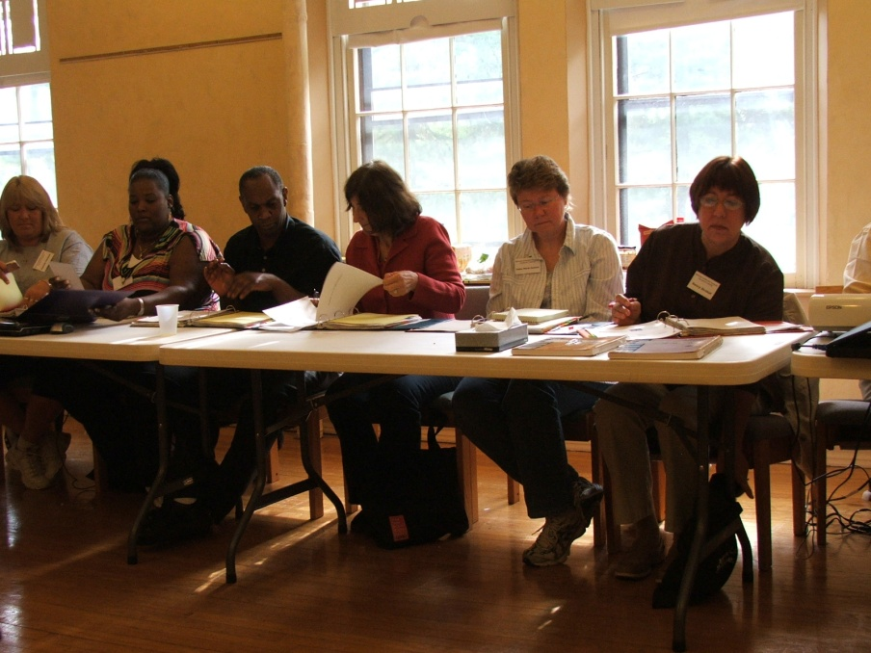
Recruitment Tips
Host listening sessions in your state
Ask in person
Give range of jobs to choose from
Ask them to do things they do well
Tell them how their job fits in
Encourage questions
Explain how this project builds the movement/organization
Present to potential for-profit and nonprofit funders
Present to community groups

Slide 7

Goal of the One on One Meeting with potential member or organization
Build the relationship
Learn about the person
  What do they care about
  What excites them
  Might motivate them to
  take action

Slide 8
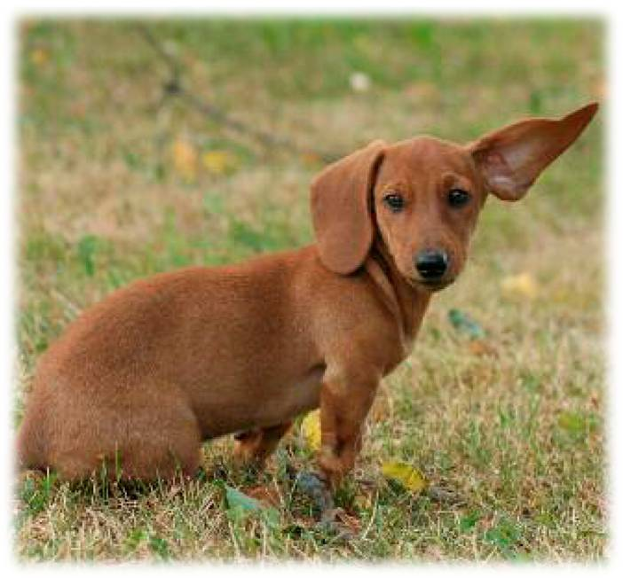
Listen
Share your purpose and passion, BUT…
they talk 70% of the time
What is their story?
How do they feel about
their work?
What is the organization’s mission?
How does the organization need your help?

Slide 9

Agitate and Recruit
Invite him/her to do something about what he/she says they care about
Ask him/her to do something specific for your organization
Ask funder to fund specific project in specific amount

Slide 10
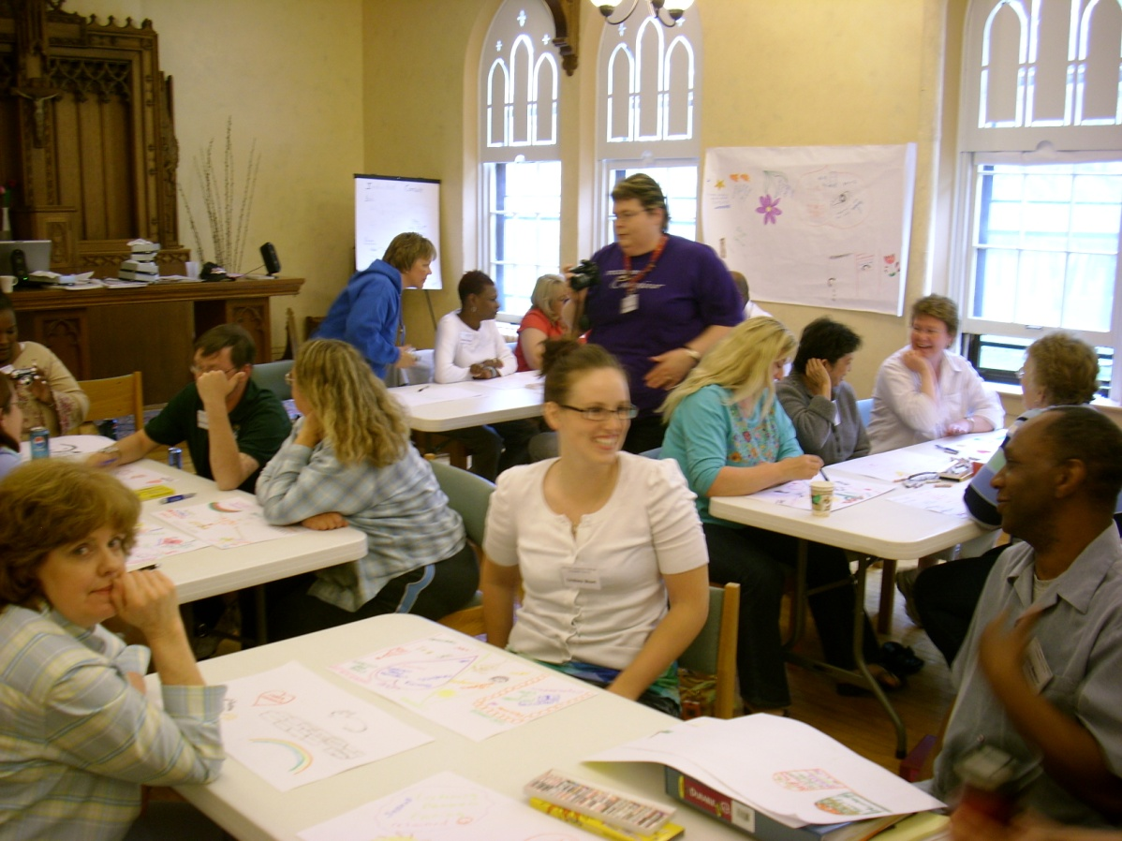
Why members Volunteer
Fun
Friendship/Relationships
Power
Recognition
Service

Slide 11
Why Funders Fund statewide association
Show support
Gain tax write-off
Advertise
Make new connections and partners

Slide 12
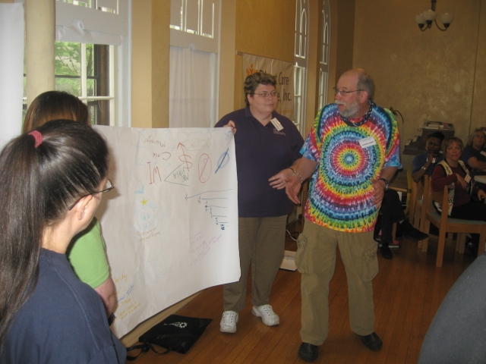
Retaining Volunteers and Funders
Inclusion
Control
Appreciation

Slide 13
For More Information
New Mexico Direct Caregivers Coalition
www.nmdirectcaresupport.org
Ph 505-867-6046

