Slide 1

Bringing Life to the Unified Caregiving Strategy
Module 1: Person- and Family- Centered Care
July 28, 2021, 2:00 pm EDT
A project of NAC made possible through support from EMD Serono, Inc.

Slide 2
Agenda
Welcome
  - NAC Team and Karen Rose, PhD, RN, FGSA, FAAN
Learning Cohort Introductions
  - State Coalition Representatives
Panel
  Moderated by Coleton Whitaker, Elizabeth Dole Foundation
  Esther Friedman- RAND Corporation, Director of the RAND Caregiving Initiative
  Leah Christensen - National Clinical Program Coordinator for the Caregiver Support Program
  Maria Loebach, RN - VA Portland Health Care System
  Miso Kwak Ed.M., Policy Analyst, National Center on Advancing Person-Centered Practices and Systems
Q&A/Open Discussion
Closing Remarks and Announcements
Notes:
During introductions, please briefly acknowledge the advisory committee, but no need to have them introduce themselves individually. Please invite 1 representative for each coalition to introduce their coalition (not necessarily each member, but generally) in 1 minute or less.
Coleton knows everyone except Miso. Miso is on vacation, but if she doesn’t forward her bio before Wednesday, please just give Coleton a heads-up and ask the panelists to introduce themselves.
Maria may not be able to attend, but Leah can cover EDF’s Campaign for Inclusive Care alone if necessary
During last 5 minutes: please invite one of the coalitions to offer closing remarks/takeways.
Thank you and Announcements – Please ask panelists if they mind leaving their emails in the chat. Also, please let everyone that we’ll be addressing Shared Decision Making in a forthcoming virtual gatherings or chat date tbd. Finally, please give a heads up that there may be some schedule adjustments for Modules 2 and 3.

Slide 3

Module Objectives – Person- and Family-Centered care
[Objective 1]

Slide 4
MEET THE COHORT!
Arizona
Florida
North Carolina
Ohio
Utah

Slide 5
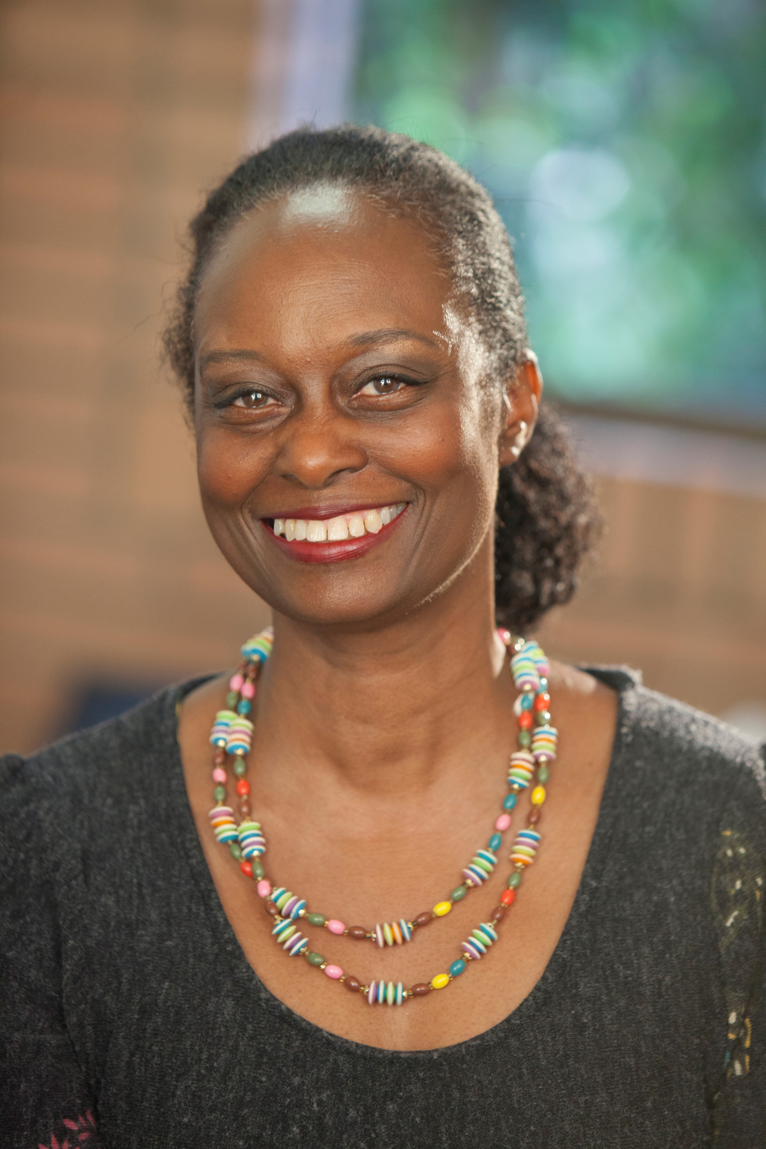
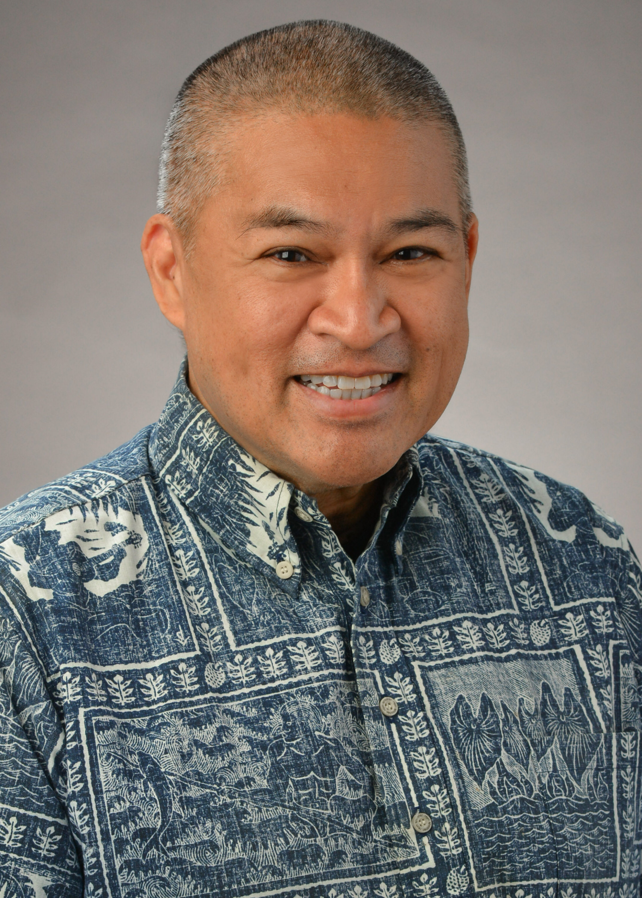
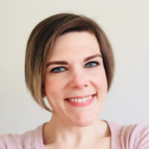

Meet the Advisory Group!
California
Donna Benton, PhD, is a research associate professor of gerontology. She is the director of the USC Family Caregiver Support Center at the USC Leonard Davis School of Gerontology. She just finished as co-chair for the California Taskforce on Family Caregiving, which led to a report which outlines recommendations for supporting family caregivers throughout the diverse communities in CA. She has worked in the field of aging for over 30 years. She is committed to promoting collaborative partnerships that enhance service delivery for families caring for older adults with long-term memory and health problems.
Hawaii
Gary Simon is the State President of AARP Hawaii and President of the Hawaii Family Caregiver Coalition. He also is the Vice Chair for the State of Hawai‘i Policy Advisory Board for Elder Affairs. Before his retirement from St. Francis Healthcare System in 2019, Simon was the Director of Corporate Affairs and Advocacy for St. Francis and previously served as Executive Director of St. Francis Hospice.”
Maryland
Jennifer Eastman is the Director of Community Living Policy at the Maryland Department of Disabilities, the only cabinet-level department in the nation that represents people of all disabilities. Her work focuses on developing programs and policies aimed at empowering people with disabilities to self-direct their services and supports and to live meaningfully within their communities. She is a qualified program developer with a record of establishing organizational and government capacity to support vulnerable populations. She also chairs Maryland Commission on Caregiving.

Slide 6
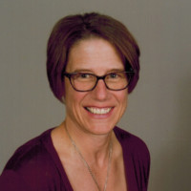
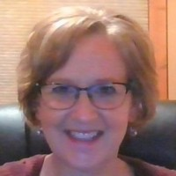
Meet the Advisory Group!
Wisconsin
Jane Mahoney has worked in the aging network for over 25 years as a Social Worker, Caregiver Coordinator, Elder Benefit Specialist and Older American’s Act Consultant. Her most recent position is with the Greater Wisconsin Agency on Aging Resources working as a Caregiver Support Specialist to oversee the National Family Caregiver Support Program and Alzheimer’s Family Caregiver Support Program. She serves on the steering committee for the Wisconsin Family and Caregiver Support Alliance and is a member of the Governor’s Task Force on Caregiving.
Wisconsin
Janet Zander is the Advocacy & Public Policy Coordinator at Greater Wisconsin Agency on Aging Resources, Inc. She is an experienced Policy Coordinator with a demonstrated history of working in the public policy industry and is skilled in Grassroots Organizing and Volunteer Management.

Slide 7
Panel Discussion
  Moderator: Coleton Whitaker, Elizabeth Dole Foundation
  Esther Friedman- RAND Corporation, Director of the RAND Caregiving Initiative
  Leah Christensen - National Clinical Program Coordinator for the Caregiver Support Program
  Maria Loebach, RN - VA Portland Health Care System
  Miso Kwak Ed.M., Policy Analyst, National Center on Advancing Person-Centered Practices and Systems

Slide 8
Q & A

Slide 9
Thank you!
NAC Project Team:
Project Manager: Mike Wittke, Vice President, Research and Advocacy (mike@caregiving.org)
Project Director: Karen Marshall, Director, Advocacy and Engagement (karen@caregiving.org)
Project Advisor: Karen Rose, PHD, RN, FGSA, FAAN, Health & Aging Policy Fellow (rose.1482@osu.edu)

