Slide 1

Policy Webinar: Caregiver Education, Training & Well-being
September 21, 2021
2:00 pm EDT
A project of NAC made possible through support from EMD Serono, Inc.

Slide 2
Agenda
Welcome & Learning Cohort Introductions
  - NAC Team and State Coalitions
Mission Moment
  - Faith Unger, M.Ed., Caregiver U Program Director, AGE of Central Texas
Panel
  Moderated by Laura J. Bauer, M.P.A., Retired National Program Director,, Operation Family Caregiver, Rosalyn Carter Institute for Caregiving
  Joseph E. Gaugler, Ph.D., Professor and Robert L. Kane Endowed Chair in Long-Term Care and Aging, Director, Public Health Center of Excellence on Dementia Caregiving, University of Minnesota School of Public Health
  Christine Jensen, Ph.D., Director of Health Services Research, Riverside Center for Excellence in Aging and Lifelong Health
Q&A/Open Discussion
Closing Remarks and Announcements

Slide 3
MEET THE COHORT!
Arizona
Florida
North Carolina
Ohio
Utah

Slide 4
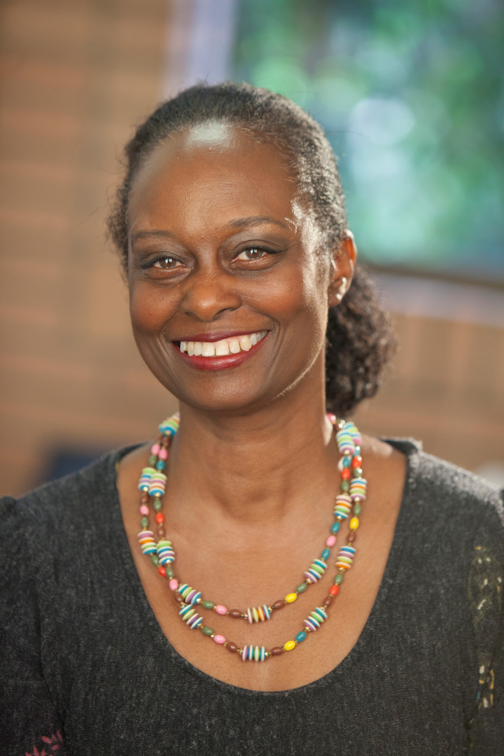
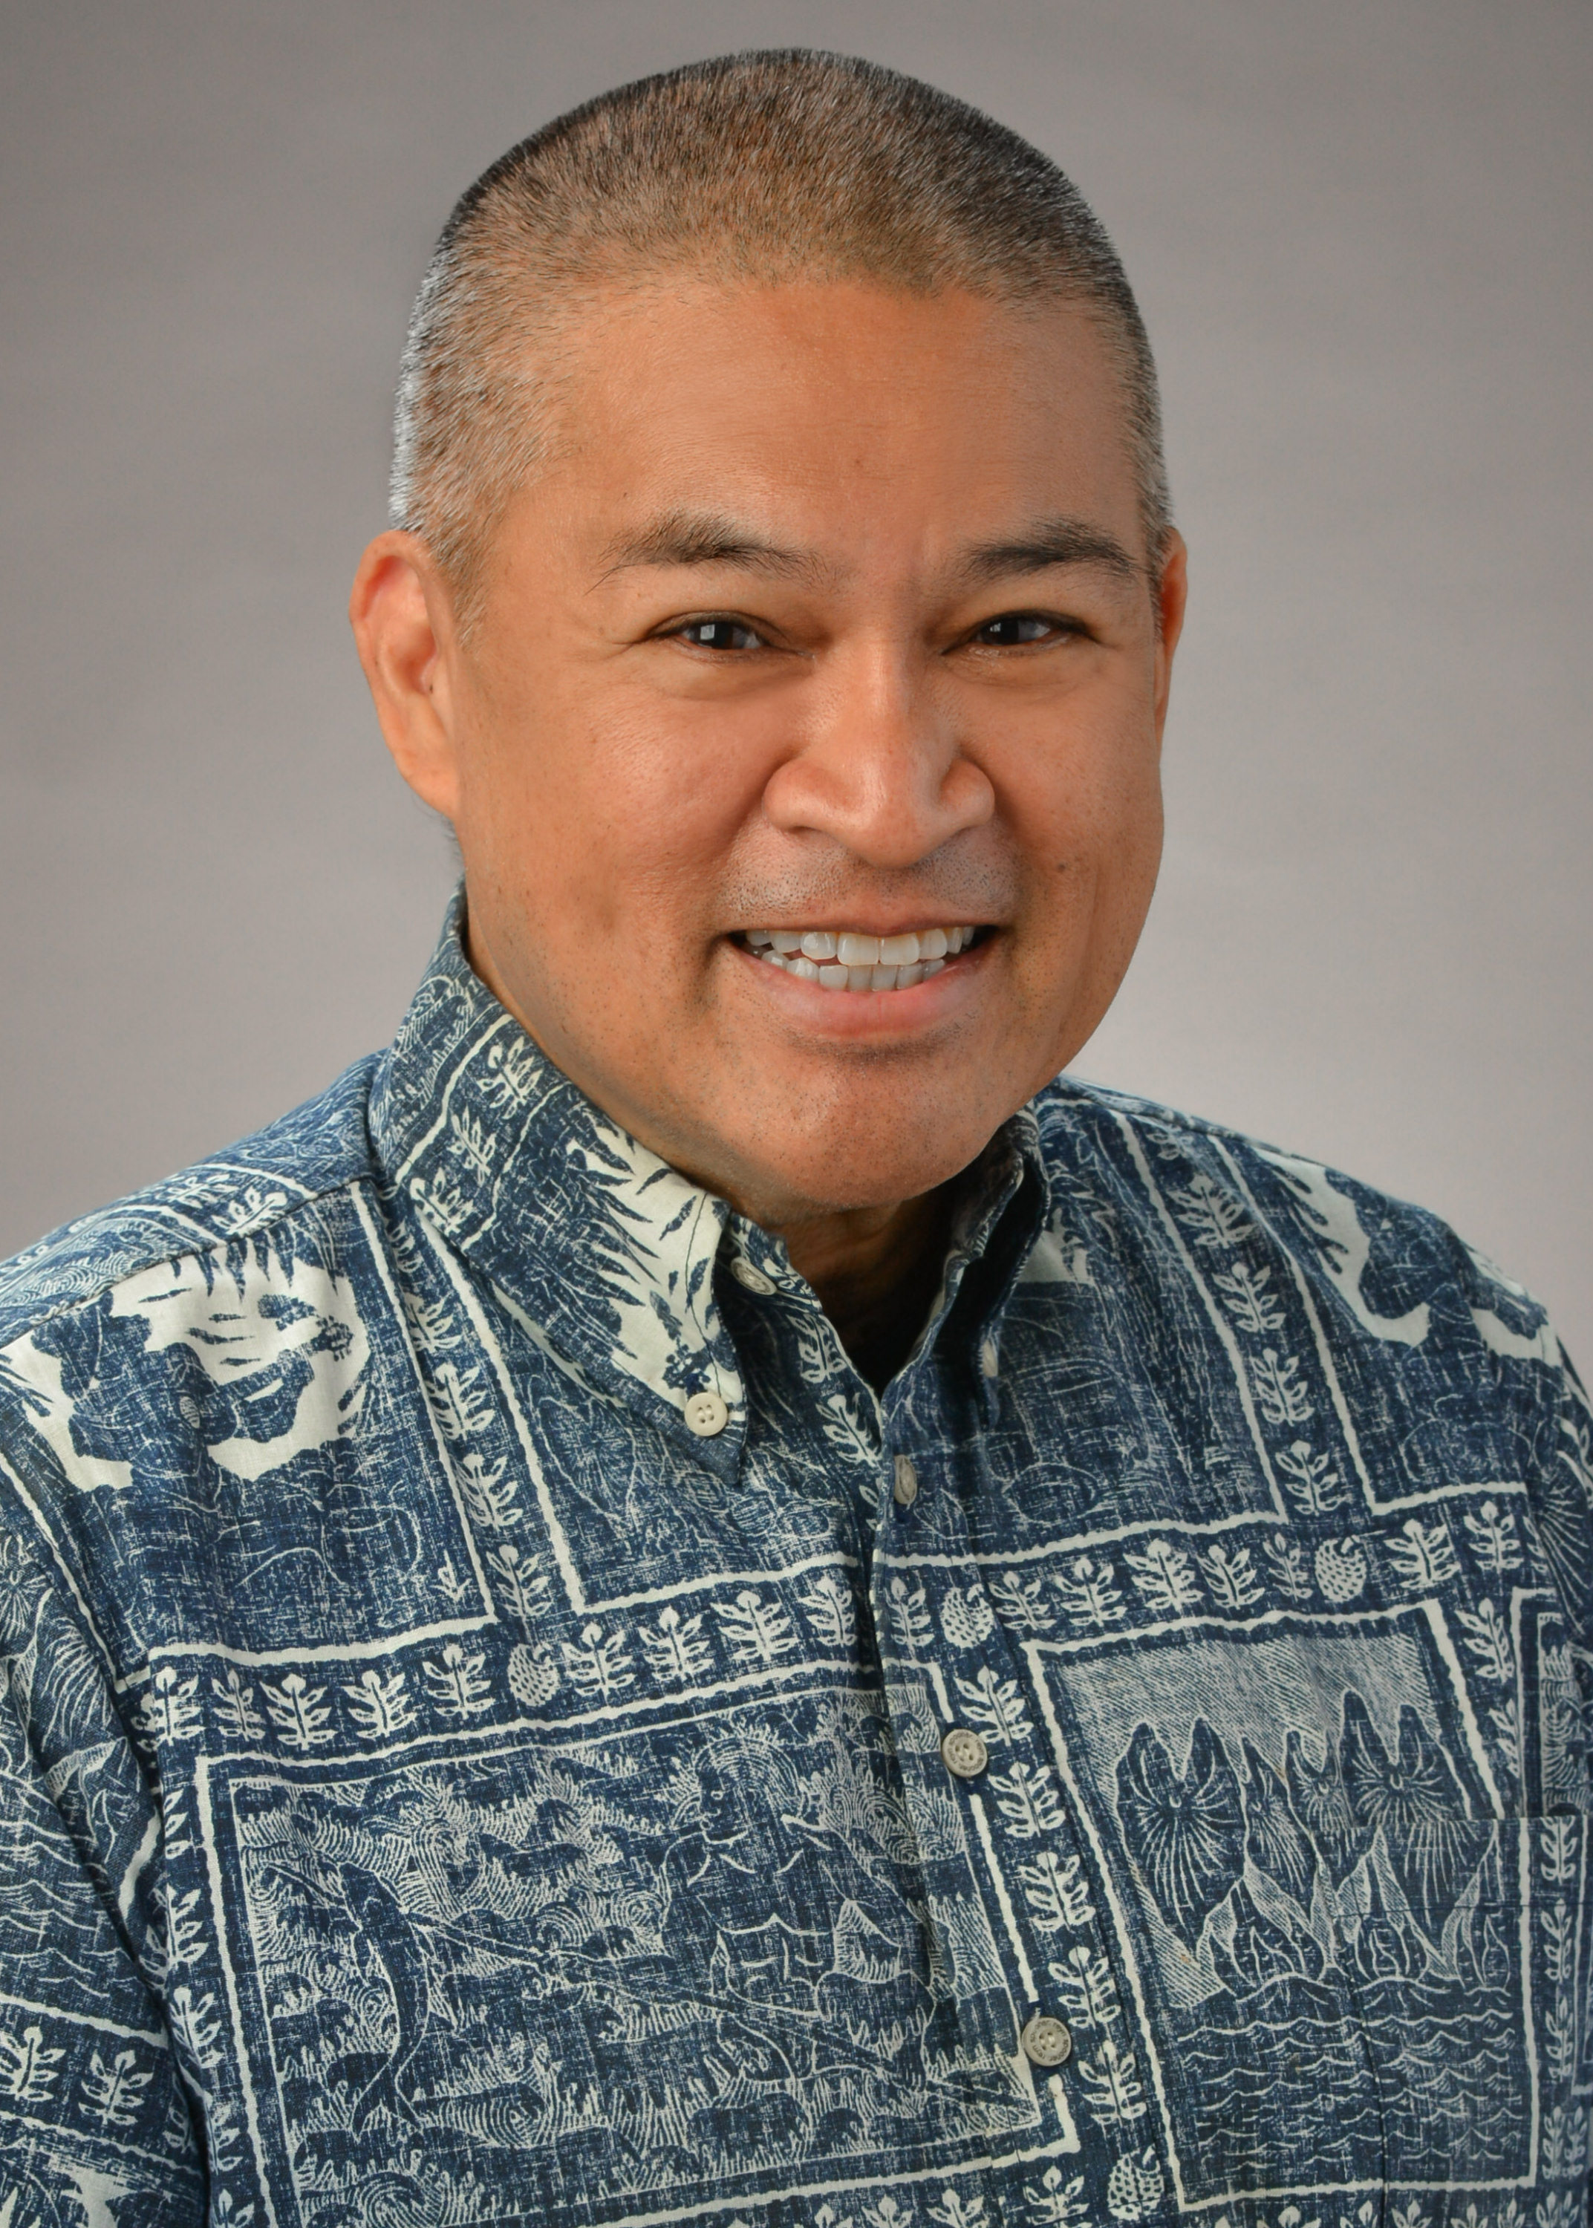
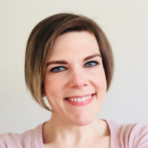

Meet the Advisory Group!
California
Donna Benton, PhD, is a research associate professor of gerontology. She is the director of the USC Family Caregiver Support Center at the USC Leonard Davis School of Gerontology. She just finished as co-chair for the California Taskforce on Family Caregiving, which led to a report which outlines recommendations for supporting family caregivers throughout the diverse communities in CA. She has worked in the field of aging for over 30 years. She is committed to promoting collaborative partnerships that enhance service delivery for families caring for older adults with long-term memory and health problems.
Hawaii
Gary Simon is the State President of AARP Hawaii and President of the Hawaii Family Caregiver Coalition. He also is the Vice Chair for the State of Hawai‘i Policy Advisory Board for Elder Affairs. Before his retirement from St. Francis Healthcare System in 2019, Simon was the Director of Corporate Affairs and Advocacy for St. Francis and previously served as Executive Director of St. Francis Hospice.”
Maryland
Jennifer Eastman is the Director of Community Living Policy at the Maryland Department of Disabilities, the only cabinet-level department in the nation that represents people of all disabilities. Her work focuses on developing programs and policies aimed at empowering people with disabilities to self-direct their services and supports and to live meaningfully within their communities. She is a qualified program developer with a record of establishing organizational and government capacity to support vulnerable populations. She also chairs Maryland Commission on Caregiving.

Slide 5
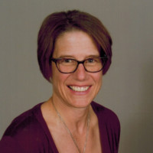
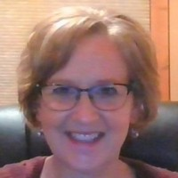
Meet the Advisory Group!
Wisconsin
Jane Mahoney has worked in the aging network for over 25 years as a Social Worker, Caregiver Coordinator, Elder Benefit Specialist and Older American’s Act Consultant. Her most recent position is with the Greater Wisconsin Agency on Aging Resources working as a Caregiver Support Specialist to oversee the National Family Caregiver Support Program and Alzheimer’s Family Caregiver Support Program. She serves on the steering committee for the Wisconsin Family and Caregiver Support Alliance and is a member of the Governor’s Task Force on Caregiving.
Wisconsin
Janet Zander is the Advocacy & Public Policy Coordinator at Greater Wisconsin Agency on Aging Resources, Inc. She is an experienced Policy Coordinator with a demonstrated history of working in the public policy industry and is skilled in Grassroots Organizing and Volunteer Management.

Slide 6


TODAY’S FOCUS AREAS
Caregiver Education, Training and Well-being
RECOMMENDATION: EXPAND CAREGIVER EDUCATION AND TRAINING TO SUPPORT CAREGIVER
WELL-BEING.
Caregiver Entry Points and Assessments
IDENTIFY SYSTEM-WIDE CAREGIVER ENTRY POINTS AND UTILIZE ASSESSMENTS TO DIRECT ACCESS TO CAREGIVER
SERVICES AND SUPPORTS.

Slide 7

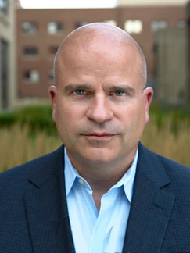
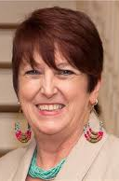
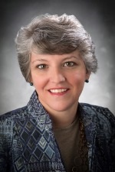
Today’s contributors
Faith Unger, M.Ed.
Mission Moment
Joseph E. Gaugler, Ph.D.
Panelist
Laura J. Bauer, M.P.A.
Moderator
Christine Jensen, Ph.D.
Panelist

Slide 8
Q & A

Slide 9
Thank you!
NAC Project Team:
Project Manager: Mike Wittke, Vice President, Research and Advocacy (mike@caregiving.org)
Project Director: Karen Marshall, Director, Advocacy and Engagement (karen@caregiving.org)
Project Advisor: Karen Rose, PHD, RN, FGSA, FAAN, Health & Aging Policy Fellow (rose.1482@osu.edu)

